Slide 1
Nao Night Extras
Just in case people want more

Slide 2
Joint control
Cover joint ranges

Slide 3
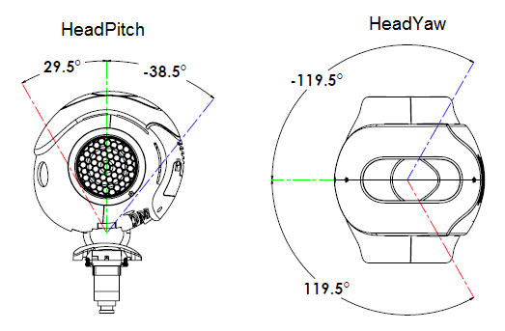
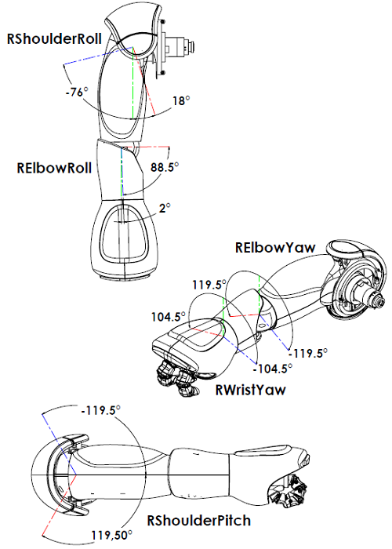
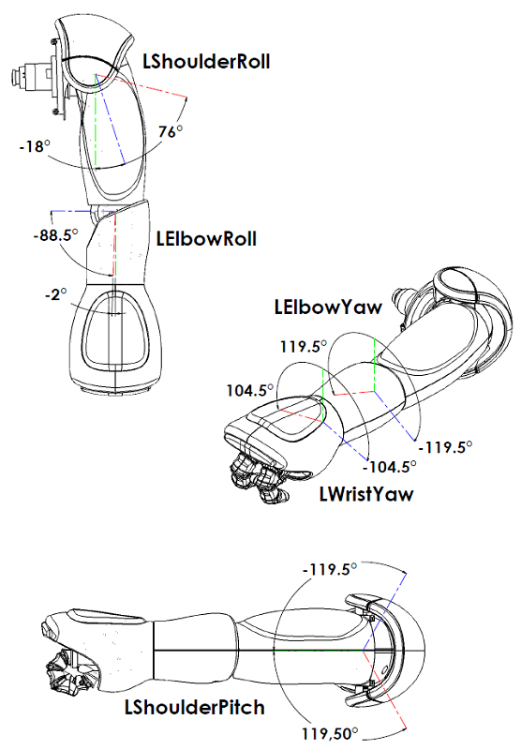
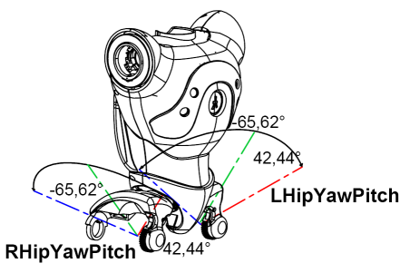

Slide 4
http://doc.aldebaran.com/2-1/family/robots/bodyparts.html#effector-chain
Or Google “Nao Effector & Chain”

Slide 5
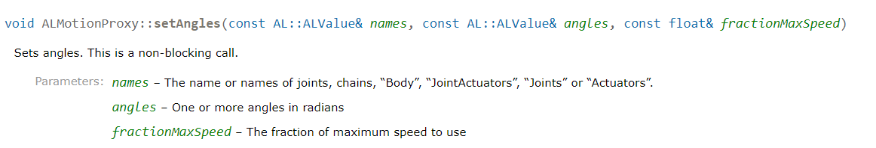
Simple example
???
Non-blocking call – the program does not wait for the method to finish before going on to the next line

Slide 6
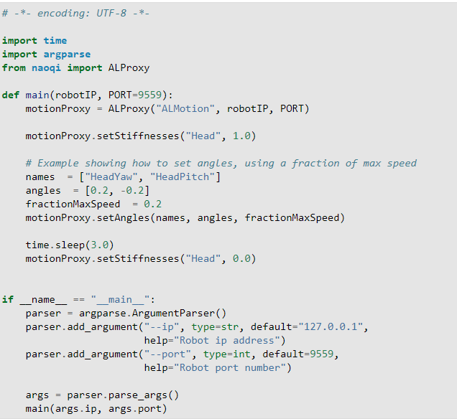
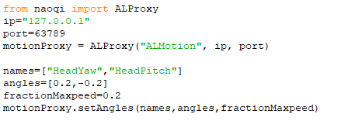

Slide 8


Slide 9
0.5148721
-0.6719518
-2.0856685
2.0856685

